Slide 1
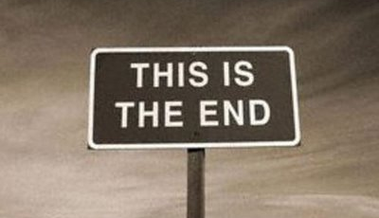
The End

Slide 2
Final, final recap…
Smells – Symptoms of hard to test
Puzzle – using oracles to express architecture
Canvas – mapping risk & remedy
Migration – testability & changing architectures
Infinite – maintaining your focus

Slide 3

Encore…

